Slide 1

A Machine Learning Project:
Predictive Analysis of Global and Regional Video Games Sales (1980 - 2015)
Prepared by:
Kristin Ferraraccio
Bassam Al-Kaaki
Jules Veloso

Slide 2

TABLE OF CONTENTS
01
Introduction
02
Dataset, Pre-processing and Approach
03
Data Exploratory and Visualization
04
Machine Learning Model Development
05
Conclusion: The Optimal Model
Notes:
Problem
Dataset, Pre-processing and Approach
Data Exploratory & Visualization
Machine Learning Models
Model Comparison
Conclusion

Slide 3

BACKGROUND
Over the years, the global industry has been experiencing unprecedented growth. By 2022, experts forecast the industry will produce 196 billion in revenue.
CLIENT, an American company is set to enter this fiercely competitive market as video game producer, and is aiming to a have a cut of the pie.
Notes:
The video gaming industry is expected to see unpredecedented growth
Client, a new player in the video game publishing, is about to enter in this fiercely competitive market as a video game publisher and wants a cut of the pie
Over the years, the global gaming industry is experience an unprecedented growth, By 2022, experts forecast the industry will produce $196 billion in revenue.
CLIENT, an American company is planning to enter the fiercely competitive market as a video game producer, aiming to have a cut of the pie.

Slide 4
MARKET SIZE
22 B
GAMERS
Microsoft says there are more than twenty-two billion gamers around the world.
REVENUE
159.3 B
The global gaming industry is estimated to generate 159.3 billion in revenue by end of the year, according to Newzoo
300 B
FORECAST
Experts predict 300 billion in revenue by 2025
Notes:
22 Billion Gamers in the world
Microsoft says there are more than two billion gamers around the world, and they're all a part of a rapidly growing global community.
$119.6 billion in revenue during 2018, according to SuperData.
Source: https://www.reuters.com/article/esports-business-gaming-revenues/report-gaming-revenue-to-top-159b-in-2020-idUSFLM8jkJMl

Slide 5
BUSINESS GOAL
PROBLEM
Generate $ 100 million revenue in 5 years
What genre of games should Client consider?
Which platforms should Client invest in when working with studios to develop games
At given genre, Which market provides more revenue opportunities?
Based on genre, platforms and market, predict the sales of a game
Notes:
What genre of games they should consider selling to drive $100M revenue in 5 years
Which platforms they should invest in when working with studios to develop games to meet their revenue goals
Which markets should they concentrate sales and marketing to meet their goals
Based on genre, platforms and markets, predict the sales of a game

Slide 6
DATASET
The dataset we will be using can be found at kaggle: https://www.kaggle.com/gregorut/videogamesales
The data consists of video games sales for pc, handhelds and consoles for games released from 1980 to 2015
The target data will be global sales
It includes the following features: Game Title, Year, genre, Platform, Publisher, Sales in NA, EUP, JPN, and Global
We will also add some additional features such as years in market, platform manufacturer, platform type and year 1 sales
The data includes close to 16,600 instances. The group plan to reduce the data to about 16,000 by removing some titles that were released from 2016 to 2020
Notes:
The data we will be using can be found at kaggle: https://www.kaggle.com/gregorut/videogamesales
The data consists of video game sales for pc, handhelds and consoles for games released from 1980 to 2015
The target data will be global sales
It includes the following features: Game Title, Year, Genre, Platform, Publisher, Sales in NA, EUP, JPN & Global
We will also add some additional features such as years in market, platform manufacturer, platform type, and year 1 sales
The data includes almost 16,600 instances (titles), but we will reduce the data to about 16,000 instances by removing some titles based on the release year (N/A, 2016, 2017, 2020)

Slide 7
PRE-PROCESSING & APPROACH
VARIABLES
Several variables needed to be removed after careful evaluation
The variables removed initially were Rank, Name, Platform, Publisher, Year, Year 1 Sales
MEASUREMENT
We used MSE as the primary measure to evaluate our models, the lower the MSE/the better the model
Depending upon the task, we also incorporated RMSE, R-squared, Significant F, P-values, & Accuracy
DUMMY VARIABLES
Several variables needed to be converted to Dummy Variables because they were nominal/categorical
The variables converted to Dummy Variables were: Genre, Platform Type, & First-Party
Did not include dummy variables for segments no longer in the market (Atari, SEGA, Other)
We used get-dummies
SCALING
TRAIN , TEST & VALIDATION DATA
Most models were run without scaling because outliers are a critical part of the data set (the top-selling games are outliers) so we did not scale the data unless the model required it (such as SGDRegressor)
We initially split the data into Train/Test (80%/20%), random state
Then split the Test data into Validation/Test (50%/50%), random state
Notes:
Kristin: Dummy Variables – confirm all that were used, where and why
Scaling – did you scale or not? We had initially agreed not to, but there might have been reasons to scale once you got into the data. What were the circumstances?
Any other methods, pre-processing anyone used?
Train/Test/Val – I followed the steps on the slide. It looks like Jules’ consultant did not create a validation set. What about Bassam’s data?

Slide 8
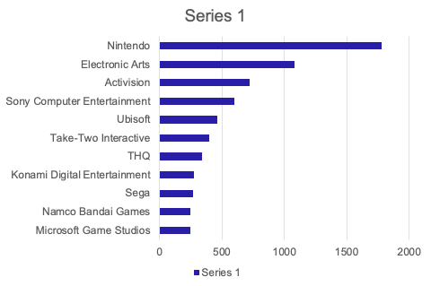











Top 10 Video Game Publishers by Sales
Nintendo’s accumulated revenue from 1995 to 2015 makes up 20% of total Global Sales during the same period
Microsoft generated less than 500 million in sales for the same period
$ 1,780
$ 1,081
$ 717.74
$ 600.72
$ 463.49
$ 396.41
$ 340.44
$ 277.35
$ 269.89
$ 247.16
$ 244.37
* Sales in Million
0 500 1000 1,500 2,000
Notes:
To generate $100M in revenue in 5 years, our client must generate $20M average annual revenue, which is slightly less than what the current Top 10 Publishers generate
There is a strong linear relationship between the number of titles a publisher releases each year and average annual sales. Our client would likely need to release 18 titles a year to generate $20M in average annual revenue.

Slide 9
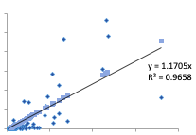
Ave Annual Sales of Publishers vs Ave No of Titles Released per Year
There is a strong linear relationship between the number of titles a publisher releases each year and average annual sales.
Client would likely need to release 18 titles a year to generate $20M in average annual revenue.
To achieve the goal of generating $100M in revenue in 5 years, our client must aim for $20M average annual revenue, which is slightly less than what the current Top 10 Publishers generate
Ave Annual Sales Predicted Ave Annual Sales
Linear (Predicted Ave Annual Sales)
$120
$100
$80
Average Annual Sales
y = 1.1705x
R2 = 0.9658
$60
$40
$20
$0
0
20
40
60
80
Average Number of Titles Release
per Year

Slide 10
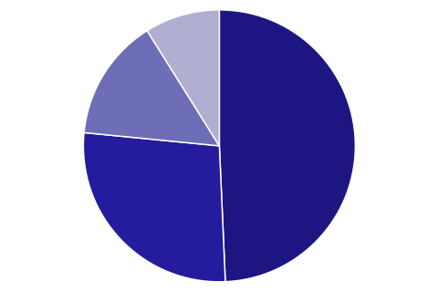
Total Sales by Region: 1980 - 2015
8%
Other Market
Japan
Japan contributed USD 1.27 billion to the global sales making it the 3rd largest market
14%
Other market includes Middle East, South East Asia, India and China
49%
27%
Europe
North America
Europe hit USD 2.4 billion sales revenue making up more than a quarter of the total global sales
North America is the largest single region for Video Game industry with an accumulated revenue of USD 4.1 billion
Notes:
Genre sales follow similar trends in North America, Europe & Other Regions, so we recommend focusing on developing games in the genres that appeal to these markets and prioritize marketing spend in the North American and European markets

Slide 11
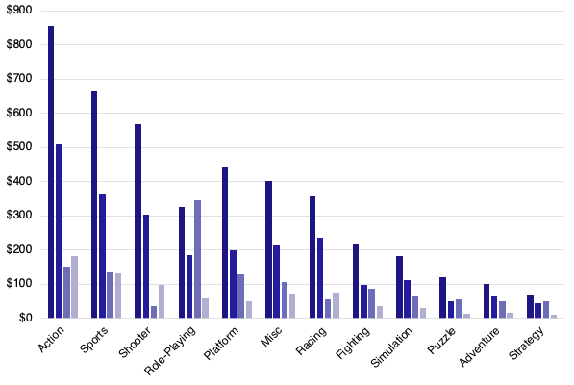
Breakdown of Sales by Genre
North America
Genre sales follow similar trends in North America, Europe & Other Regions, so we recommend focusing on developing games in the genres that appeal to these markets and prioritize marketing spend in the North American and European markets
Europe
Japan
Other Market
* Sales in Million

Slide 12
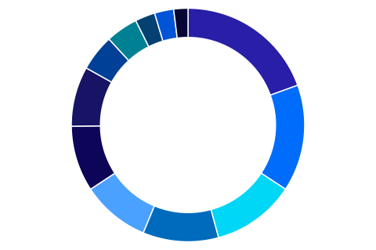

Total Sales Revenue by Genre
Adventure
$ 232
Strategy
$ 172
Puzzle
$ 242
Simulation
$ 389
Action
$ 1,702
Sports, Shooters, Role-Playing, & Platform account for 4 of the top 5 best-selling genres of all time and generate the highest revenue per title.
Action is the leading genre and the field is very competitive as there are more Action titles released every year than any other genre, which tends to diminish the average sales per title for the genre.
3%
2%
3%
Fighting
$ 440
4%
19%
%5
Racing
$ 725
8%
15%
Sports
$ 1,294
Misc
$ 796
9%
9%
12%
Platform
$ 827
11%
Shooter
$ 1,007
Role-playing
$ 917
* Sales Revenue in Millions
Notes:
Our client should consider releasing games in the Sports, Shooters, Role-Playing, Platform, & Action genres.

Slide 13
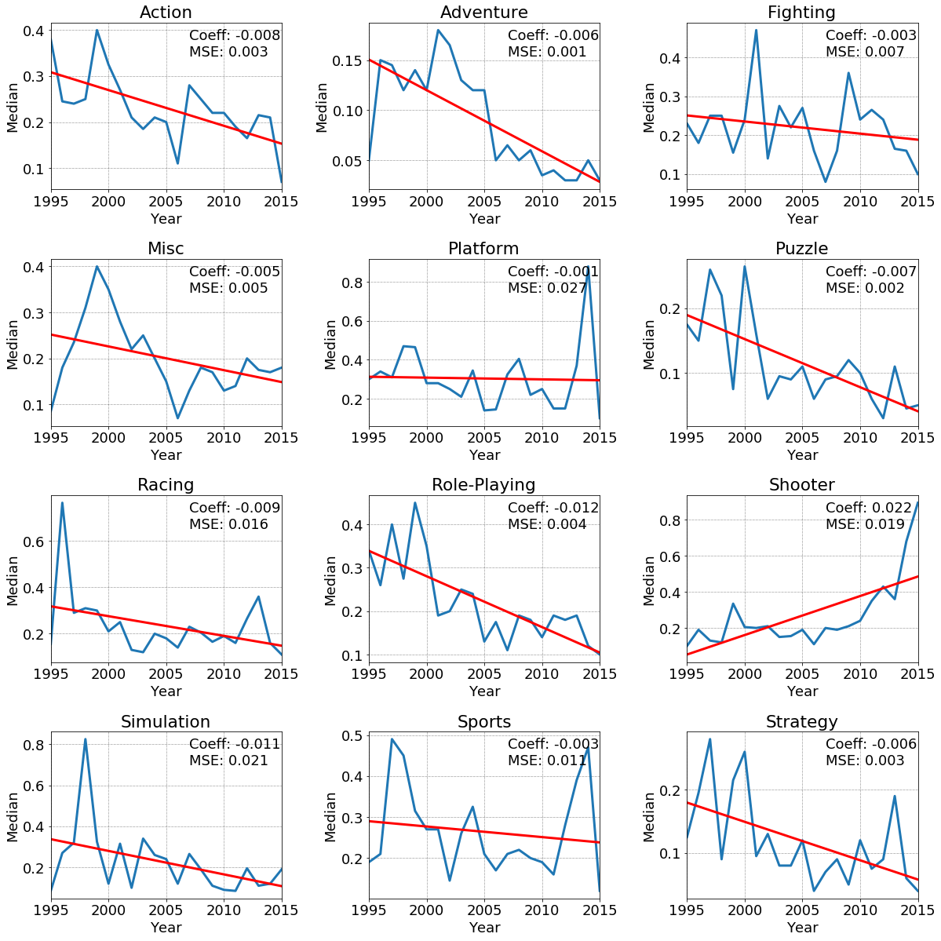
Genre Trends
Action
Adventure
Fighting
Misc
Shooters is the only genre showing in increase in sales trends
Yearly Sales trends are a good predictor of a genre’s future performance with all genres showing mse less than .027
The model is not as strong for Platform games as other genres (mse is the highest at .027)
Other genres are showing declines, so other considerations should be taken before investing in other genres
Platform
Puzzle
Racing
Role-Playing
MEDIAN
Shooter
Simulation
Sports
Strategy
YEAR

Slide 14
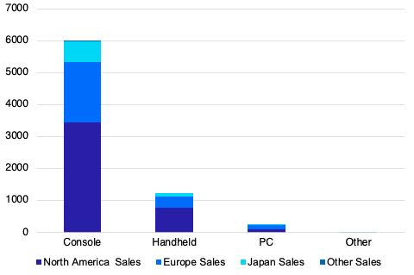
Sales by Platform Type
$7,000
Console Games have generated significantly greater revenue than other platform types and are the top-selling platform type across all regions.
$6,000
North America
Europe
$5,000
Japan
Other Market
$4,000
Sales in Million
$3,000
$2,000
$1,,000
$0
Console
Handheld
PC
Others

Slide 15
Ave Sales by Platform Type
$100,000
Console Games generate the highest sales revenue per title followed by Handheld.
We recommend that our client prioritize developing Console Games.
$80,000
$60,000
$40,000
$20,000
$0
Console
Handheld
PC
Others
Notes:
98083.02
65896.08
52117.12
9357.801

Slide 16
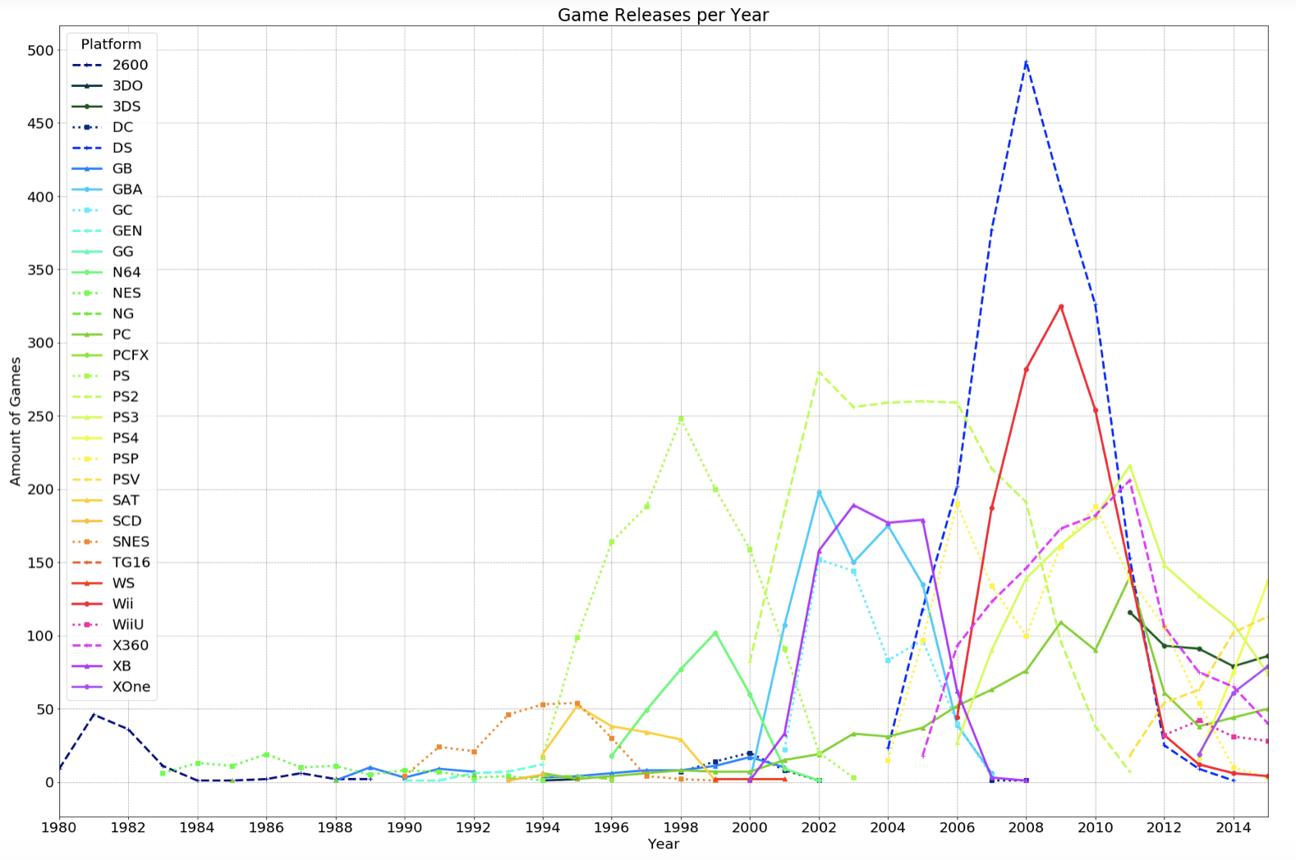
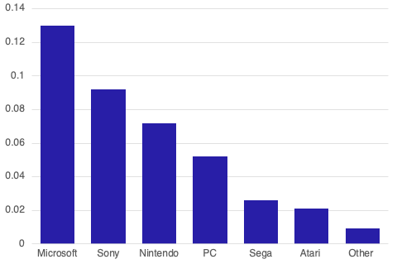
Number of Games Produced by First Party and their Ave Annual Sales
Gamers have shifted their preference of First-Party Platforms over the years and Sony, Microsoft & Nintendo have dominated the scene over the past 10 years
Microsoft generate the highest average annuals sales per title, followed by Sony
We recommend our client prioritize developing games for Microsoft & Sony platforms
Game Releases per Year
Average Annual Sales by First Party
* Sales in Million

Slide 17
MODELS SELECTED
We chose to use Supervised Learning because all of our data has labels
We selected a variety of Regression Models because our target data is continuous and our final goal is to provide a predictive equation that the client could use to optimize revenue
There is a linear relationship between many of the variables and the target data
Due to some issues with our first set of models, we also ran some classifiers
Lastly, we also ran Kmeans Clustering, but have not included the results in this presentation
REGRESSION MODELS
CLASSIFIER MODELS
LINEAR REGRESSION
KNN
RANDOM FOREST
ENSEMBLE
KNN
DECISION TREE
SciKit Learn: LinearRegression, SGDRegressor
Statsmodel OLS
Y-predictive equation using intercept & coefficients to predict sales
ScikitLearn: Knearest Neighbor Regressor
Not all variables have linear relationships
ScikitLearn: Random Forest Regressor
Not dependent on linear relationships
Feature Selection
ScikitLearn: Voting Regressor
Input from 3 different models
ScikitLearn: Knearest Neighbor Classifier
Kbins Discretizor used to split data into high/med/low sales
ScikitLearn: Decision Tree Classifier
Kbins Discretizor used to split data into high/med/low sales
Not dependent on linear relationships

Slide 18
MODEL COMPARISON: Predicting Sales based on Entire Dataset of Features
Linear Regression delivered the best results (.000025 MSE) because there is a high degree of linearity between Regional Sales & Global Sales
However, all of the models below are somewhat flawed because they include Regional Sales and there is strong multi-collinearity so despite the strong results, the models don’t really help us tell our client what types of games to develop
Iteration No. | Model | Parameters | MSE | R-Squared | Running Time (sec)
1 | Linear Regression | Default Parameters | 2.72E-05 | 0.9999 | 0.0114
2 | SGD Regressor | Default Parameters: penalty = l2, alpha = 0.0, max iter = 1000 | 2.76E-05 | 0.9999 | 0.0093
3 | SGD Regressor | Penalty =l1, alpha = 0.0, max iter = 1000 | 2.75E-05 | 0.9999 | 0.0088
4 | SGD Regressor | Penalty = l2, alpha = 0.5, max iter = 1000 | 0.0701 | 0.966 | 0.0147
5 | SGD Regressor | Penalty = l2, alpha = 0.2, learning rate = optimal, max iter = 10000 | 0.0252 | 0.9877 | 0.013
6 | Knearest Neighbor | N-neighbors = 10, Euclidean distance | 0.16 | 0.92 | 0.0089
7 | Knearest Neighbor | N-neighbors = 3, Euclidean distance | 0.09 | 0.95 | 0.0125

Slide 19
MODEL COMPARISON: Predicting Sales based on Entire Dataset of Features
Iteration No. | Model | Parameters | MSE | R-Squared | Running Time (sec)
8 | Knearest Neighbor | N-neighbors = 4, Manhattan distance | 0.13 | 0.94 | 0.0074
9 | Random Forest Regressor | Default parameters, n_estimators = 100 | 0.08 | 0.96 | 0.008
10 | Random Forest Regressor | n_estimators = 100, max_leaf_nodes = 16 | 0.13 | 0.94 | 0.013
11 | Random Forest Regressor | n_estimators = 500, max_leaf_nodes = 5 | 0.31 | 0.85 | 0.0089
12 | Random Forest Regressor | n_estimators = 100, oob score = true, bootstrap = true) | 0.06 | 0.97 | 0.0356
13 | Voting Regressor (soft voting) | Default Parameters with 3 models (Linear Regression, Knearest Neighbor, Random Forest using default parameters) | 0.02 | 0.99 | 0.012

Slide 20
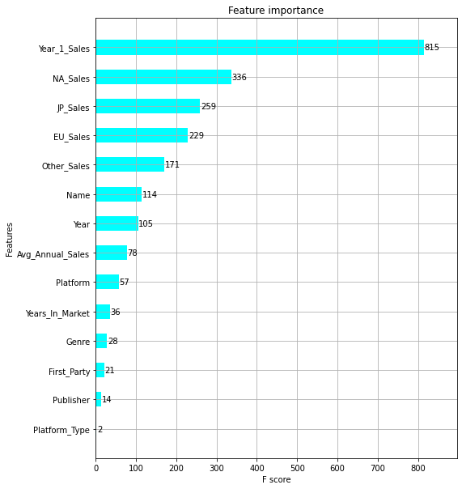
FEATURE IMPORTANCE
Year 1 Sales, North America Sales and Japan Sales are the three most important features.

Slide 21
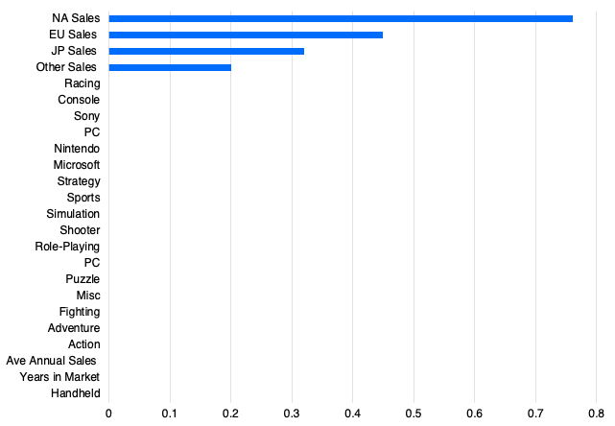
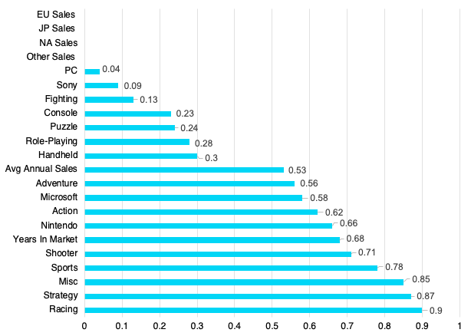
FEATURE ENGINEERING: Correlations, Embedded Feature Selection, p-values
Three methods of feature selection suggested we only keep the Regional Sales features in our model
These variables help us understand where to prioritize selling games, but they do not help explain what type of games to develop and for what platforms
Feature Variables with
Correlation > .50 Global Sales
Feature Importance using Lasso Model
Feature Variables’ p value
0.94
0.90
0.74
0.65
0.61
NA Sales
Other Sales
EU Sales
Japan Sales
Ave Annual Sales
Notes:
0.94 - NA
0.9 - EU
0.61 - JP
0.74 - Other
0.65 - Avg Annual Sales

Slide 22
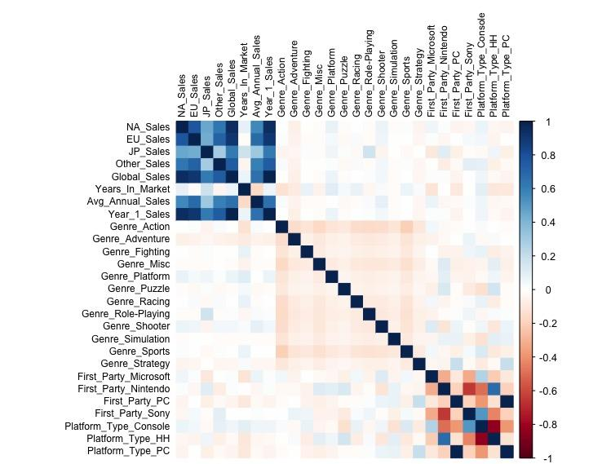
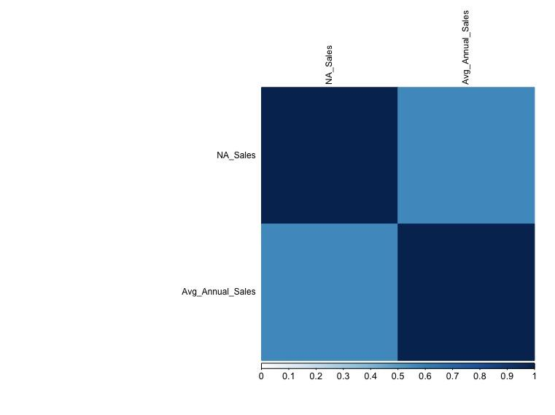
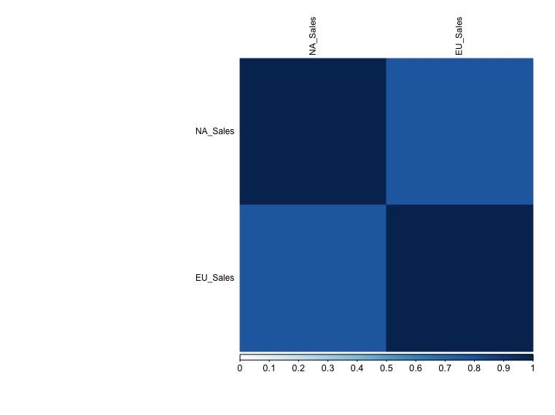
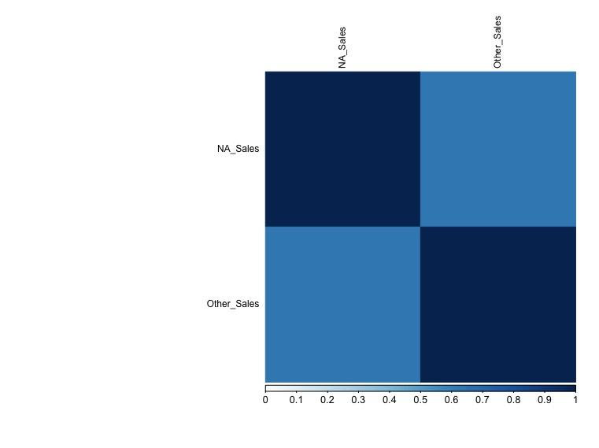
FEATURE ENGINEERING: Multi-collinearity
Furthermore, most of these variables also show significant multi-collinearity with one another
This suggests we should keep the variable with the highest correlation to Global Sales (NA Sales) and remove the others that have high collinearity with NA Sales (EU Sales, Other Sales, & Average Annual Sales)
Ave Annual
Sales
NA
Sales
NA
Sales
1
0.56
NA
Sales
EU
Sales
Ave Annual
Sales
0.56
1
NA
Sales
1
0.77
NA
Sales
Other
Sales
EU
Sales
0.77
1
NA
Sales
1
0.63
Other
Sales
0.63
1

Slide 23
MODEL COMPARISON: Predicting sales, excluding Regional Sales
Despite various Feature Selection methods suggesting that Genre, Platform Type & First-Party were not significant, we ran the models without Regional and Average Annual Sales data
KNN with 26 neighbors was the best performing model when regional sales & average annual sales were removed, but performance is poor & it is not a reliable model for predicting video game sales
KNN likely performed better than Linear Regression because of the lack of linear relationship between Global Sales, Genre, Platform Type & First Party
lteration No | Model | Parameters | MSE | R-Squared | Running Time (sec)
1 | Linear Regression | Default Parameters | 2.04 | .0091 | .012
2 | SGD Regressor | Default Parameters: penalty = l2, alpha = 0.0, max iter = 1000 | 2.08 | -.0105 | .017
3 | SGD Regressor | Penalty =l1, alpha = 0.0, max iter = 1000 | 2.05 | .0011 | .011
4 | SGD Regressor | Penalty = l2, alpha = 0.5, max iter = 1000 | 2.05 | .0060 | .019
5 | SGD Regressor | Penalty = l2, alpha = 0.2, learning rate = optimal, max I iter = 10000 | 2.04 | .089 | .008
6 | Knearest Neighbor | N-neighbors = 10, Euclidean distance | 2.16 | -.0506 | .008
7 | Knearest Neighbor | N-neighbors = 26, Euclidean distance | 2.03 | .0130 | .007

Slide 24
MODEL COMPARISON: Predicting sales, excluding Regional Sales
Model # | Model | Parameters | MSE | R-Squared | Running Time (sec)
8 | Knearest Neighbor | N-neighbors = 26, Manhattan distance | 2.04 | .0110 | .008
9 | Random Forest Regressor | Default parameters, n_estimators = 100 | 2.45 | -.1871 | .010
10 | Random Forest Regressor | n_estimators = 100, max_leaf_nodes = 16 | 2.25 | -.0920 | .008
11 | Random Forest Regressor | n_estimators = 500, max_leaf_nodes = 5 | 2.06 | .0010 | .007
12 | Random Forest Regressor | n_estimators = 100, oob score = true, bootstrap = true) | 2.45 | -.1876 | .008
13 | Voting Regressor (soft voting) | Default Parameters with 3 models (Linear Regression, Knearest Neighbor, Random Forest using default parameters) | 2.14 | -.0364 | .010

Slide 25
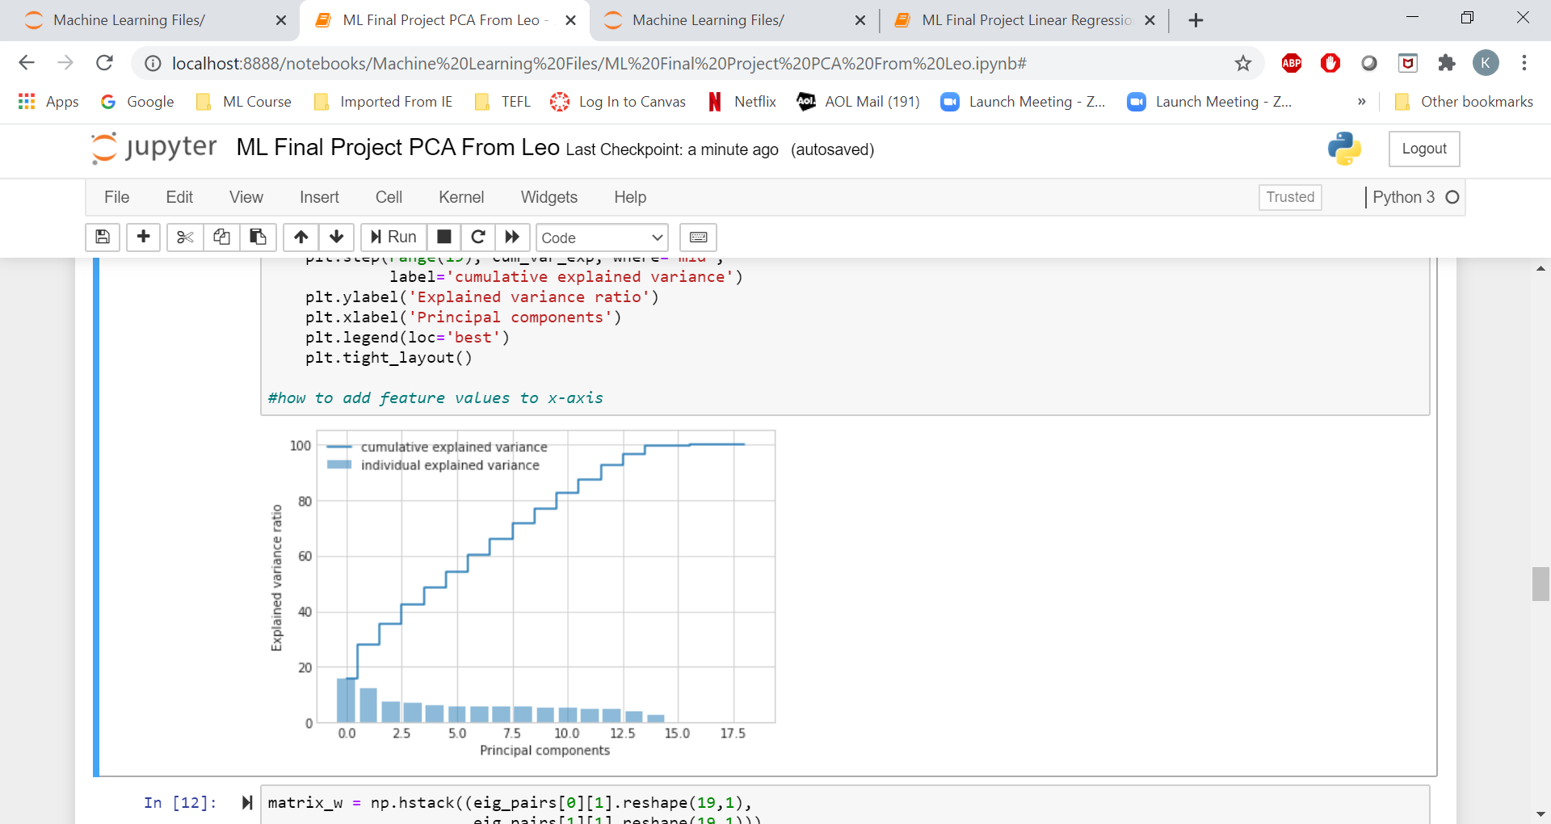
DIMENSIONALITY REDUCTION: PCA
After running the regression models without Regional Sales, we applied the Principal Component Analysis (PCA), a dimensionality reduction algorithm to identify the most important variables
PCA suggested that 14 of the 19 variables explained the variance
After running the model with the 14 variables, we did not see any improvement in the results compared to the best model previously (KNN)

Slide 26
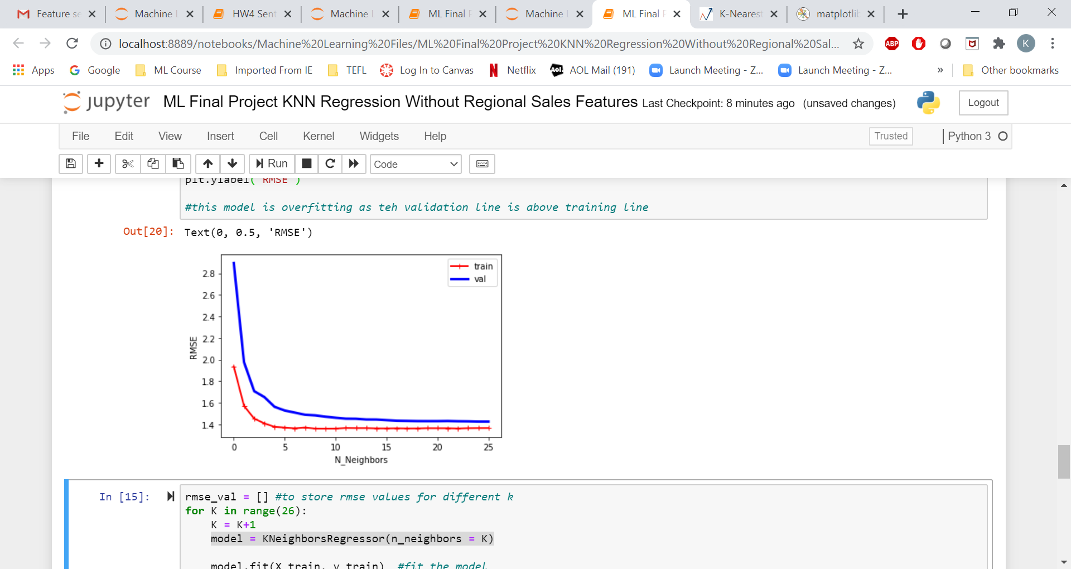
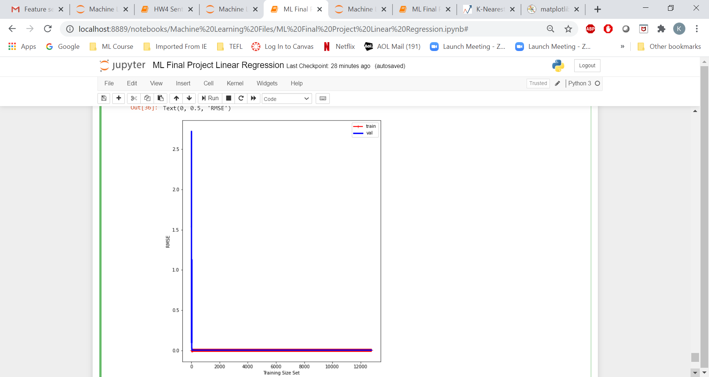
MODEL LEARNING CURVES
The Linear Regression model that included Regional Sales did not show signs of over-fitting or under-fitting
The KNN Regression model that did not include Regional Sales shows signs of over-fitting
Best Performing Model with Regional Sales
Linear Regression
Best Performing Model without Regional Sales
KNN Regressor (26 N_Neighbors)
train
val
2.5
2.0
RMSE
1.5
1.0
0.5
0
0
20,000
40,000
60,000
80,000
100,000
120,000
Training Set Size

Slide 27
BEST FEATURES FOR PREDICTING GLOBAL SALES
Feature | MSE | R-Squared
NA & EU Sales | 0.10 | 97.6%
Genre | 4.33 | 0.4%
Platform Type | 4.34 | 0.3%
First Party | 4.34 | 0.2%
In addition to running multi-variate models, we ran simple linear regression models with each variable group
We saw similar results as the other models
Regional sales are the highest predictor of Global sales
NA & EU Sales can explain almost 98% of total Global Sales for a title
Genre, Platform, & First Party are not good predictors of Global Sales
Based on Linear Regression, default parameters
Test Set = 20% of sample
Get_Dummies Used for Genre, Platform Type, First Party

Slide 28
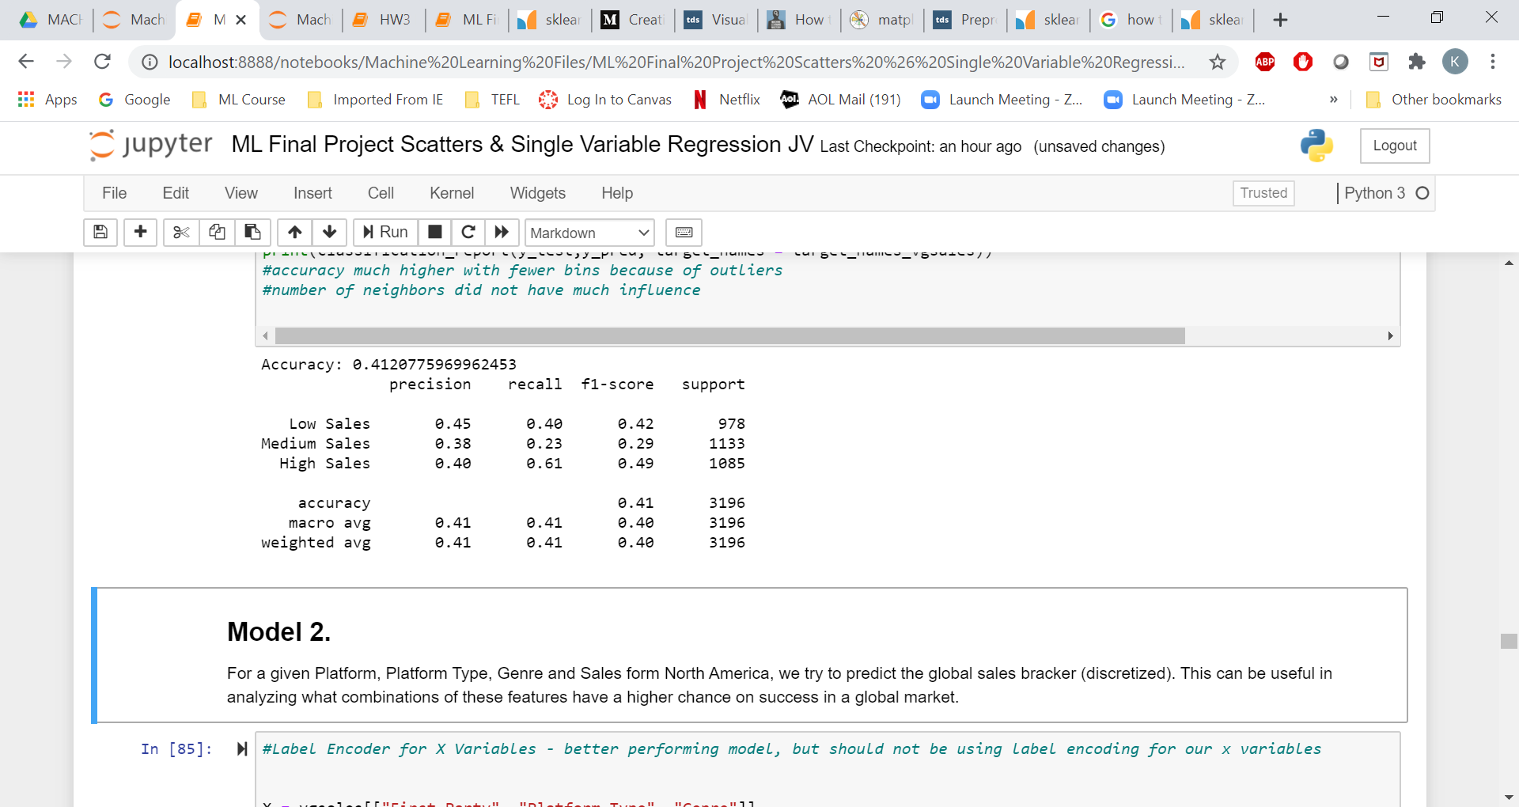
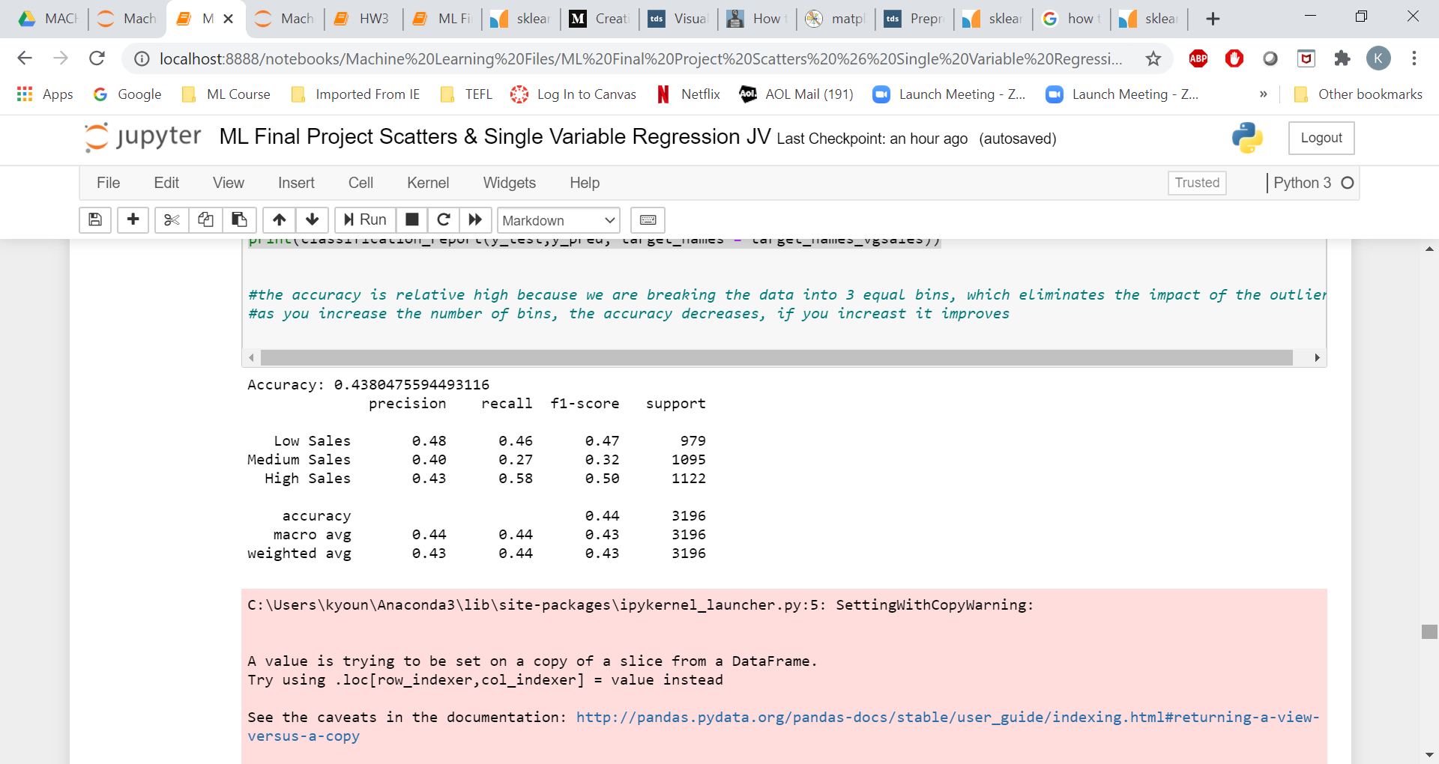
USING CLASSIFIERS INSTEAD OF REGRESSION: Genre, Platform Type, First Party Variables
After seeing poor results with Linear Regression when the model only included Genre, Platform Type & First Party, we used Kbins Discretizer to split Global Sales into classes (3 equal sizes – high, medium, low sales)
We conducted two different classification analysis on the data: KNN and Decision Tree
The models yielded less than 50% accuracy with the Decision Tree Classifier slightly better at 44% a
Precision is the more important metric than Recall for our project and both models show higher precision than recall for Low & Medium Sales, but not High Sales
KNN Classifier
Decision Tree Classifier
Based on Kbins Discretizer, 3 Bins, Quantile Strategy (JV’s models)
Test Set = 20% of sample
Get_Dummies Used for Genre, Platform Type, First Party

Slide 29
MODEL COMPARISON & CONTRAST
PROS
CONS
Relatively fast; Works well when variables with strong linear relationship were included
Best results when Regional Sales are included
Slower than other models
Poor results with variables without strong linear relationship
LINEAR REGRESSION
Poor results when regional sales were not included
K NEAREST NEIGHBOR REGRESSOR
Fastest running model
Best results when Regional Sales are not included
Relatively fast
Did not yield better result than other models
RANDOM FOREST REGRESSOR
Relatively fast
Soft voting results in an MSE that is better than some models and worse than others
Worst performing model without regional sales
VOTING REGRESSOR
Relatively fast
Relatively poor accuracy
3 bins are probably not sufficient
K NEAREST NEIGHBOR CLASSIFIER
DECISION TREE CLASSIFIER
Much better accuracy than K Nearest Neighbor Classifier because of lack of linear relationship
Precision is poorer for high volume classes than Recall
3 bins are probably not sufficient
Notes:
Precision is poorer for high volume classes than Recall
3 Bins probably not sufficient

Slide 30


CONCLUSION : OPTIMAL MODEL
Based on the models we built and the feature selection methods we employed, we are unlikely to select with confidence an optimal model that can address client’s objectives.
However, we can use the data to understand the following at a macro-level :
The biggest market opportunity in generating revenue are North America and Europe.
The genres Action, Shooter, Sports, Role-Playing are most likely to contribute to higher revenue.
The video game must be available in console
Sony and Microsoft are considered most reliable first-parties.
With the limited data at hand, we are not able to build a predictive sales equation.

Slide 31
Summary
Our data was not sufficient to help us develop an equation that we could share with our client to predict the sales of a game based on genre, platform or first-party.
Nor could we build a model that could help determine the optimal combination between genre, platform type and first-party to help our client generate $100M in the first 5 years.
We have provided a macro view of the category landscape based on our exploratory data & analysis which helps our client understand where to focus, the number of games to target per year, and which genres, platform types, and first-parties to prioritize.
In order to build a model that would allow us to predict game sales, the client would need to invest in additional data sources.

Slide 32

FURTHER EXPLORATION: Additional Data
Here are some suggestions of additional data to gather for the client:
1
Year One Sales, Average annual sales during first 5 years of Catalogue
Year 1 sales are the best indicators of a game’s catalogue sales and would likely be a better indicator than Lifetime Global Sales. Source: NPD Group
2
5
Game Reviews
Do game reviews influence sales?
Source IGN, Metacritic, GameSpot:
Game Demographics
Do game skew towards certain demographic?
Source: NPD, Internal Quantitative Research
3
6
Gameplay Modes
Do types of gameplay modes influence sales?
Source: IGN, Metacritic, GameSpot, NPD
DLC, Add-ons (post launch)
Does additional content drive sales?
Source: IGN
4
7
Launch Advertising Spend
Did marketing drive sales post-launch?
Source: Statista, 3rd Party Ad agencies
Incentives
Do incentive drive sales during launch?
Source: IGN, Metacritic
Notes:
If we had access to the data above, it could also allow us to conduct more complex, unsupervised modeling such as clustering and deep neural networks

Slide 33
FURTHER EXPLANATION: Models to Explore
Due to the lack of linear relationship between Global Sales, Genre, Platform Type & First Party, consider Polynomial Regression. This is more complex & would require additional information about the relationship among feature variables
Consider building a Regression MLP neural network. Additional layers could help find relationships among feature variables. This could be challenging to interpret and explain to the client and may not have enough instances to optimize a neural network
Consider using Clustering for Anomaly Detection. The most successful games are outliers in Global Sales so understanding if there are similar features among the anomalies could help drive decisions as to which type of game to make Consider clustering methods beyond K-means because of the disparity in the size of the clusters
Revisit the analysis by console generation. Trends have shifted over the years and some of the shift could be driven by console generation (example: PS2 vs PS3 vs PS4). Re-running the models based on Platform vs Platform Type or by splitting the years of data by generation could offer additional insights that are more relevant to today’s landscape
Text Sentiment Analysis based on Title Name. Rather than create tens of thousands of dummy variables based on the names for linear regression, we could conduct a regression analysis based on the sentiment of the words used for names to determine if there are any words or combinations of words are linked to sales.

Slide 34
THANKS
GAME OVER
Email us with questions.

Slide 35
APPENDIX

Slide 36
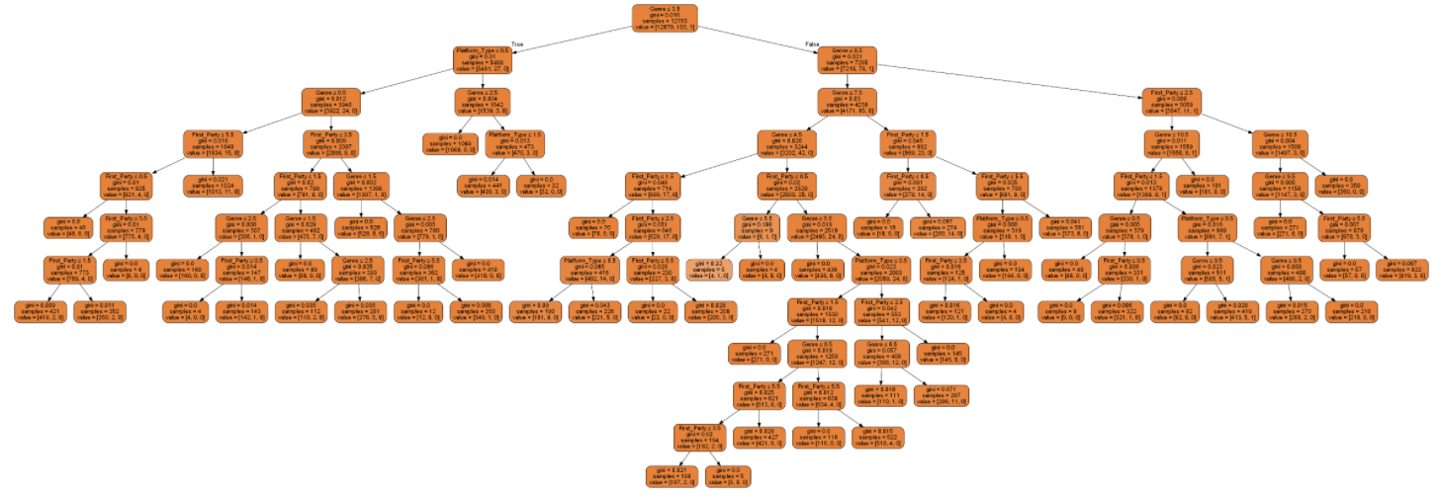
DECISION TREE (CLASSIFIER)
*Best viewed in python file: ML Final Project Scatters & Single Variable Regression JV

Slide 37
Ave Annual Sales and Ave No of New Release by Genre
Ave Annual Sales per Title by Genre
Ave No of New Release by Genre
$ 0.30
250
$ 0.25
200
$ 0.20
150
Ave Annual Sales per Title in millions
$ 0.15
Ave No of New Releases
100
$ 0.10
50
$ 0.05
$ 0.00
0
Shooter
Platform
Role-Playing
Sports
Action
Racing
Fighting
Misc
Simulation
Puzzle
Strategy
Adventure

